Slide 1


Dynamic Memory Allocation Self-referential Structure
Md. Rafidul Hasan Khan
Lecturer, Dept. of CSE, FSIT
rafidul.cse0401.c@diu.edu.bd

Slide 2
Dynamic Memory Allocation (1/4)
Allocate memory dynamically i.e. when the program runs in the memory
Powerful concept of programming dynamic structure
Memory is allocated form the hep location of the memory
Dynamic memory allocation is the heart of the data structure
@DIUBLC
‹#›

Slide 3
Dynamic Memory Allocation(2/4)
How to allocate memory dynamically?
Use the library function malloc() form the library stdlib.h
Syntax: int *p; p = (int*) malloc(n * sizeof(int));
First declare a pointer of the desired type
In this case int *p; (pointer of type int)
Second call the function malloc()
the first part (int*) is called type cast (used to convert the character pointer returned by malloc to desired type and in this cae int)
n is the number of location
sizeof is a macro function to get the size of data type in byte
sizeof(int) means get byte for int data type
@DIUBLC
‹#›

Slide 4
Dynamic Memory Allocation (3/4)
Some example:
int *p;
p = (int *) malloc(4 * sizeof(int) );
[p is a pointer pointing to an array now]
0 1 2 3
p[0] = 5; p[1] = 7;
5 | 7
@DIUBLC
‹#›

Slide 5
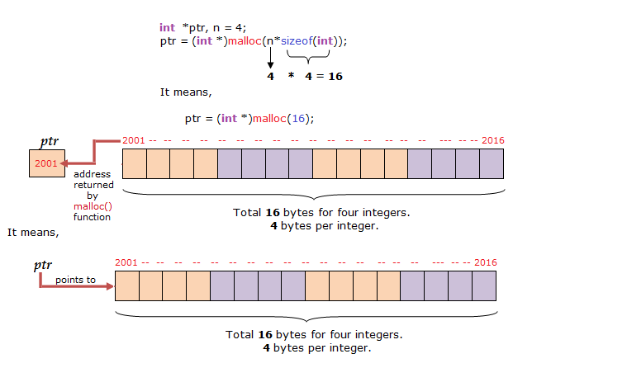
Dynamic Memory Allocation (4/4)
@DIUBLC
‹#›

Slide 6
Self-Referential Structure (1/4)
A structure (struct in c) whose one member is a pointer of its own type
e.g
struct Point{
int data;
struct Point *pt;}
pt is a pointer member of the type struct Point
pt is a pointer member of the same type
It is called a self-referential structure as it refer to itself
data pt
(how it looks like)
@DIUBLC
‹#›

Slide 7
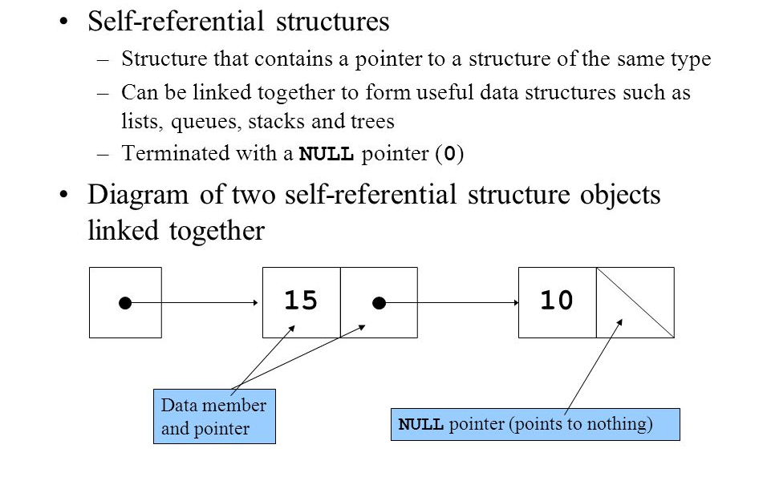
Self-Referential Structure (2/4)
@DIUBLC
‹#›

Slide 8
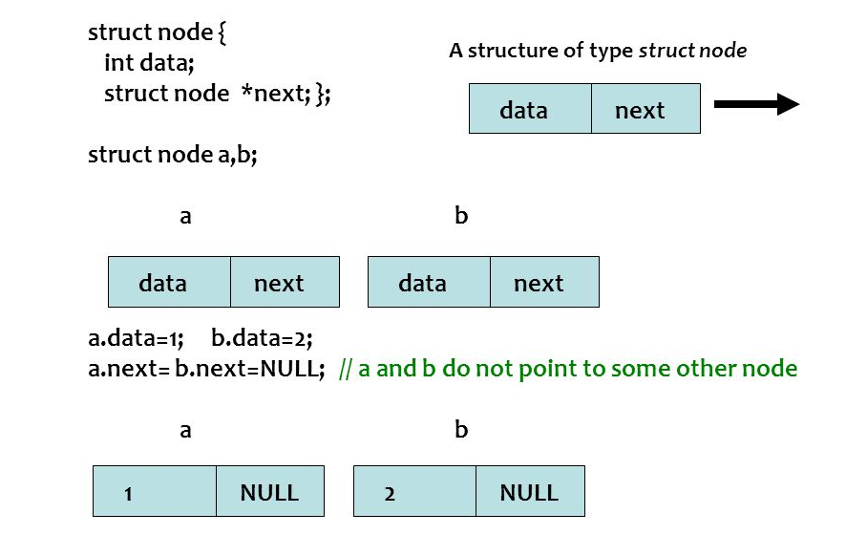
Self-Referential Structure (3/4)
@DIUBLC
‹#›

Slide 9
Self-Referential Structure (4/4)
struct Point{
int data;
struct Point *pt; };
typedef struct Point point;
…
point *head;
head = (point*) malloc(sizeof(point));
head->data = 5;
head->pt = (point*) malloc(sizeof(point));
head->pt->data=7; head->pt->pt=NULL;
head
5
7
null
@DIUBLC
‹#›

Slide 10
Summary
Dynamic memory allocation is the key to create dynamic allocation
Self-referential structure plays the most vital role in dynamic data structure
@DIUBLC
‹#›

